Slide 1
Burglar Alarm System
Powering India
Sahil Kumarwar-201060035
Risheel Chheda-201060030
Lavanya Tembhurne-201060028
Vishwesh Jadhav-201060071

Slide 2
Contents
Introduction
System Overview
Arduino Board
Sensors
Circuit Diagram
Programming
Testing and Operation

Slide 3
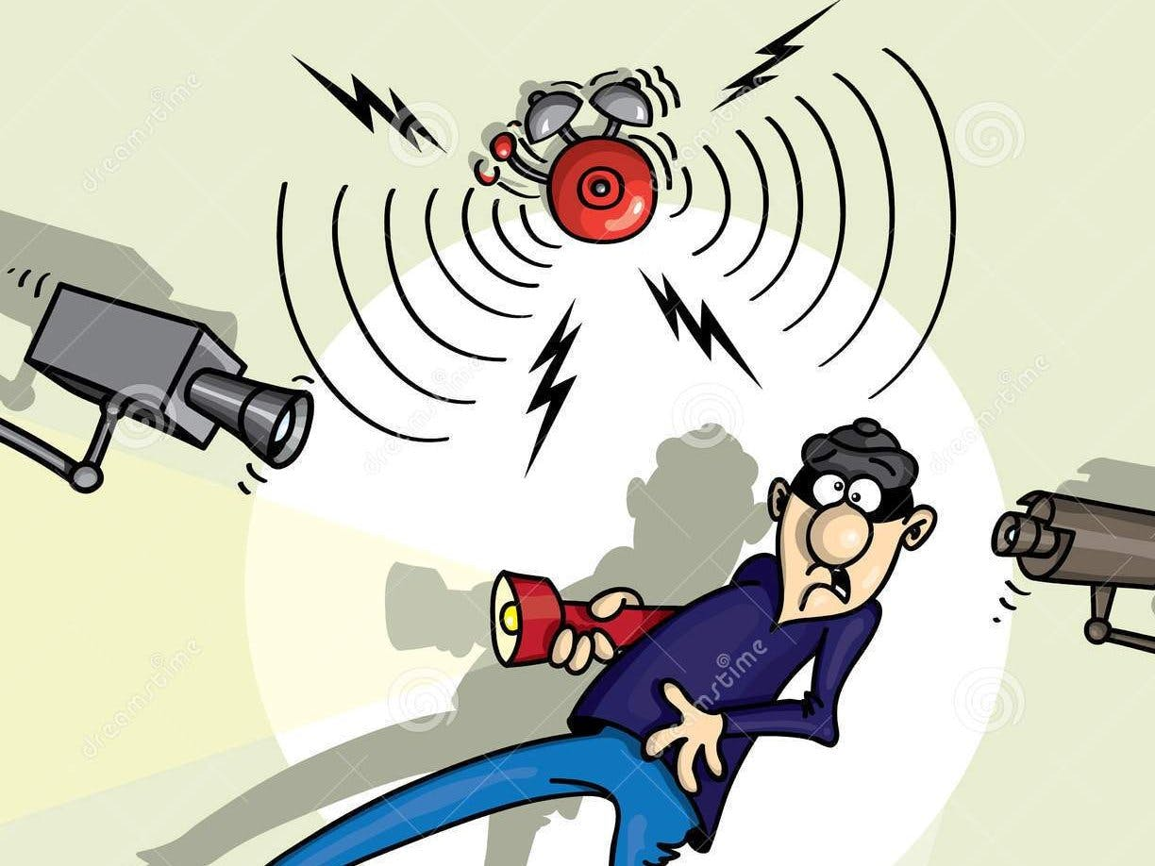
Introduction
A burglar alarm system is a security system designed to detect unauthorized entry into a building or area.
It plays a crucial role in protecting homes and properties from burglary and providing peace of mind to homeowners.

Slide 4
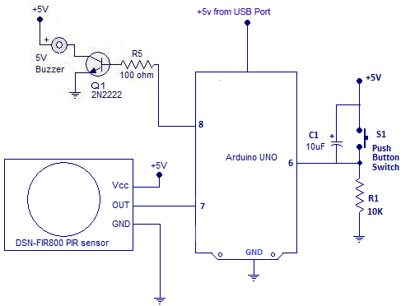
System Overview
The burglar alarm system using Arduino consists of various components working together.
Block diagram:
Arduino board: Acts as the brain of the system, controlling and coordinating the different components.
Sensors: Detect any unauthorized entry or movement.
Buzzer: Produces an audible alert when the system is triggered.
LED: Provides a visual indication of the system's status.
Power source: Supplies power to the Arduino and other components.

Slide 5
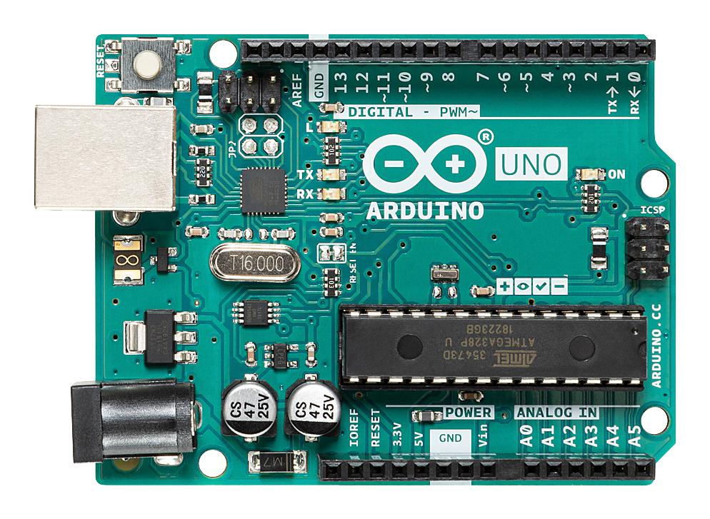
Arduino Board
Arduino is an open-source
microcontroller board widely used for building electronic projects.
It provides an easy-to-use platform for programming and controlling various hardware components.

Slide 6
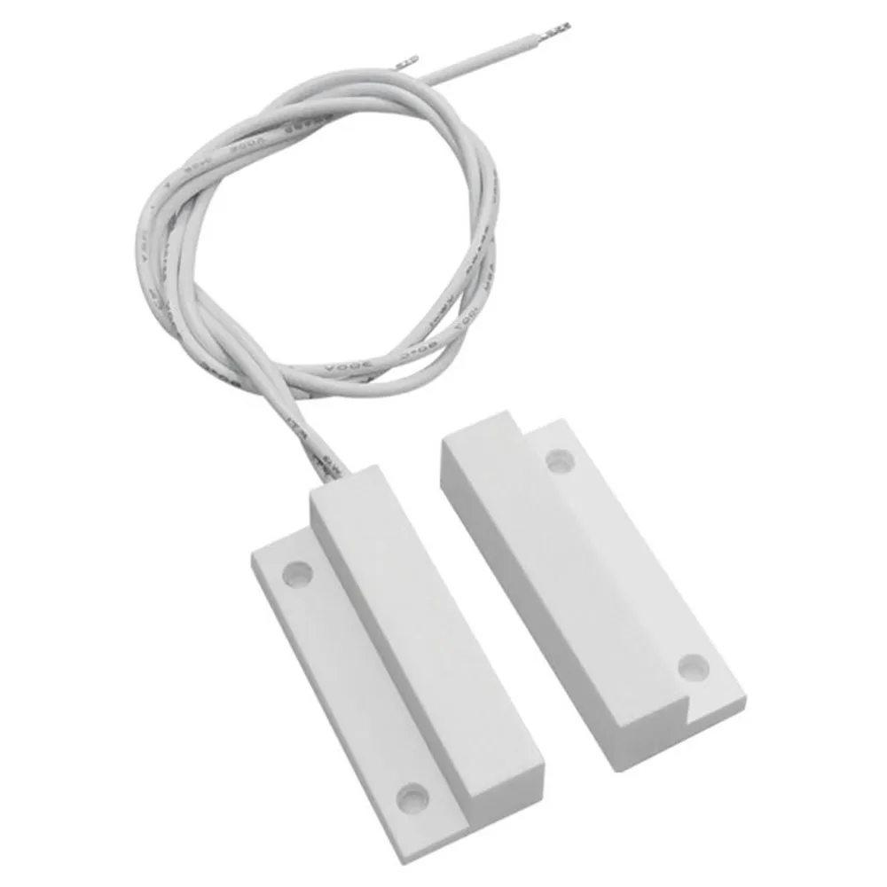
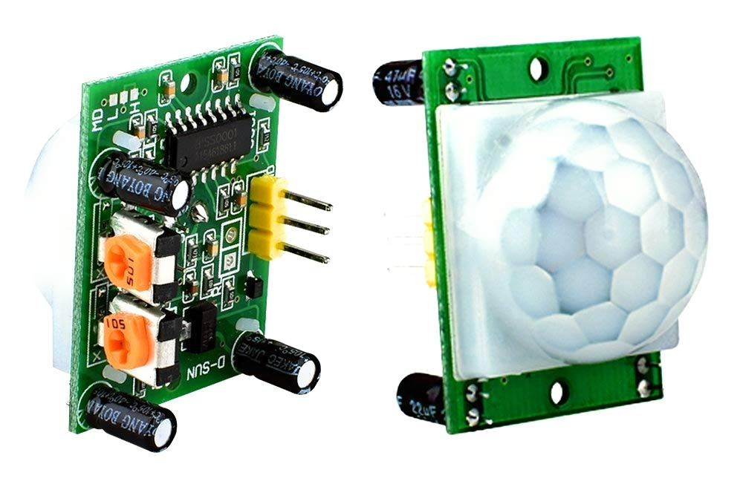
Sensors
The burglar alarm system uses two types of sensors:
PIR (Passive Infrared) sensor: Detects changes in infrared radiation emitted by moving objects.
Magnetic contact sensor: Detects the opening or closing of doors and windows.
These sensors are strategically placed to monitor potential entry points.
PIR Sensor
Magnetic contact sensor

Slide 7
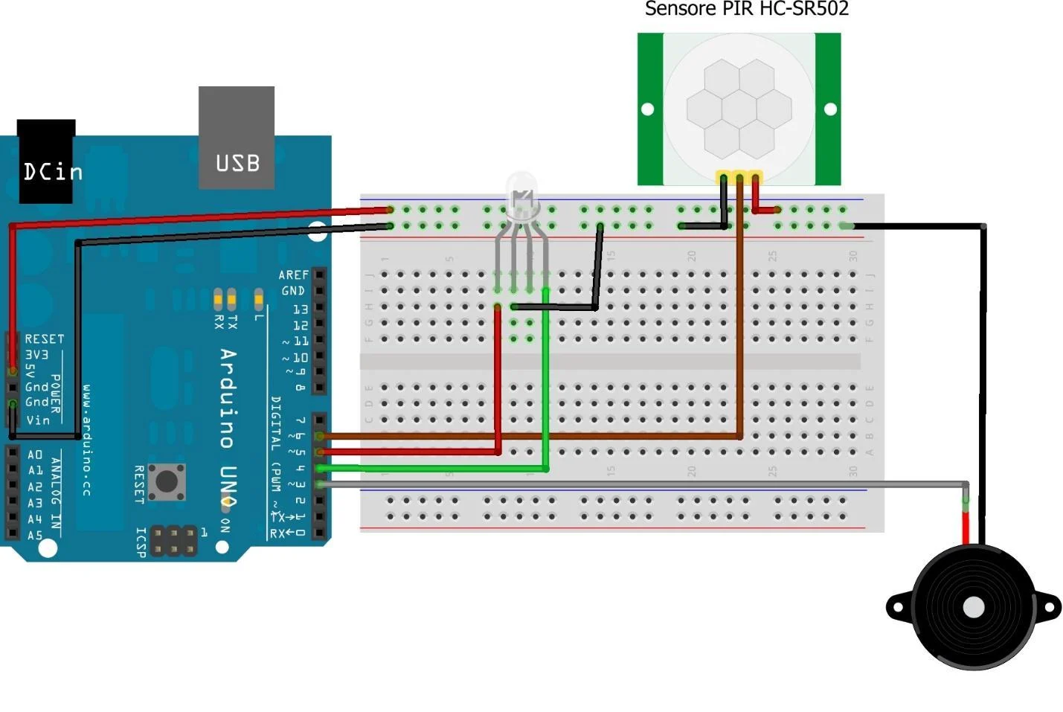
Wiring Diagram
Proper wiring is crucial for the correct functioning of the burglar alarm system.
Make proper connections and replicate the circuit as shown in the image.

Slide 8
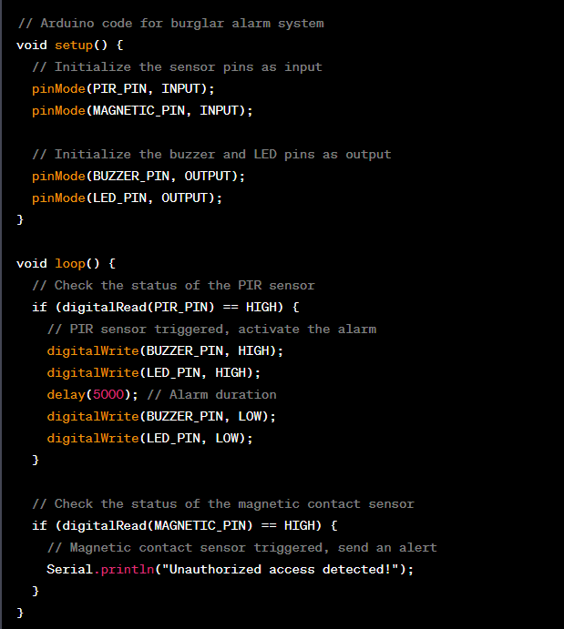
Programming

Slide 9
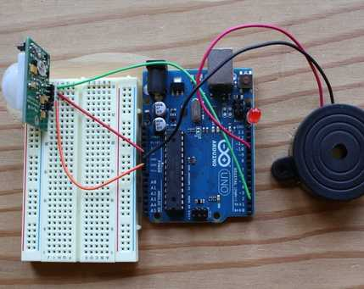
Testing And Operation
After completing the wiring and programming, follow these steps to test the burglar alarm system:
Power on the Arduino and ensure all connections are secure.
Move in front of the PIR sensor to trigger the alarm.
Open or close a door/window connected to the magnetic contact sensor to check for alerts.
Observe the buzzer and LED response.

Slide 10
Thank You

